Slide 1

Web Games Development 1 Week 8
Alan.Williams@uws.ac.uk
Notes:
Lecture: Overview of Assessment 2 and start looking at game environment within Phaser. Next week, we will begin to look more into Phaser and character movement and begin looking at creating a game as part of the lab.
Lab: In the lab you are going to look at using Piskel and Tiled to help design and produce a game environment.

Slide 2
Assessment 2 – The Game
Submission Deadline - 28th November 2019 by 4pm.
Develop a web game using Phaser (65%).
2D game of any genre using Phaser 3.19.0 (Naofumi).
This allows everyone to use the same version of Phaser.
Assessment criteria:
Features (40%).
Usability and Interactivity (15%).
Interface (10%).
Video Promotion (5%).
Notes:
The submission for Assessment 2 is due on the 28th November 2019 by 4pm. This includes developing a web games using the appropriate JavaScript Games Framework which for this module would be using Phaser. This is worth the 65% of your overall module mark and for Assessment criteria/ marking scheme we will be looking for 4 individual sections for this submission; features, usability and interactivity, interface and video promotion.
When using Phaser, I recommend everyone using Phaser 3.19.0 (Naofumi) meaning that everyone on the module is working from the same version of Phaser 3.

Slide 3
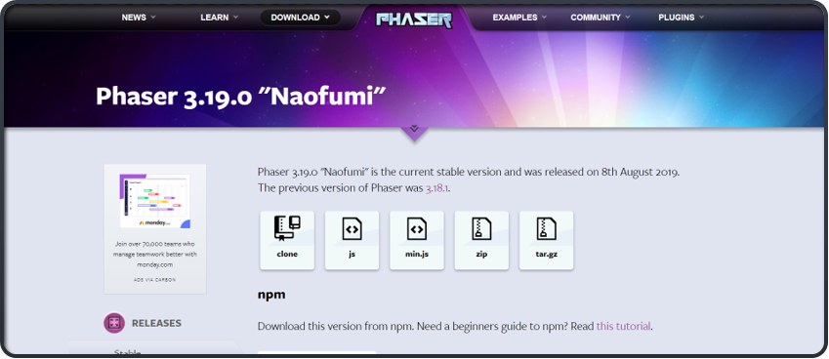
Downloading Phaser Library
Reminder to use Phaser 3.19.0 “Naofumi”.
Means everybody will be using the same version of Phaser.
JS or min.JS are both the same except min.JS offers minified files that takes up less space and loads faster while saving bandwidth.
Notes:
Brief reminder of what must be done to download Phaser.
Phaser 3.19.0 “Naofumi” is the version I recommend everybody uses so we are all working from the same version.
min.js is recommended as it offers “minified files” which take up less space and load faster while saving bandwidth.

Slide 4
Assessment 2 – The Game
Features (40%):
What are the features implemented? How complex and creative are the features that are implemented compared to any existing games? If there is a story to be told in the game, is the story interesting and has it successfully conveyed to the player? Is there relevant music and sound effects implemented? How complex and creative is the implementation?
Usability and Interactivity (15%):
Can the game be played immediately? Is there any instructions on how to play the game? Are the game states distinct (main menu, pause, play game, game over)?
Interface (10%):
How does the game look (background, colour pattern/ palette, assets etc.)?
Video Promotion (5%):
A trailer that highlights your game; this should be no longer than 30-45 seconds.

Slide 5
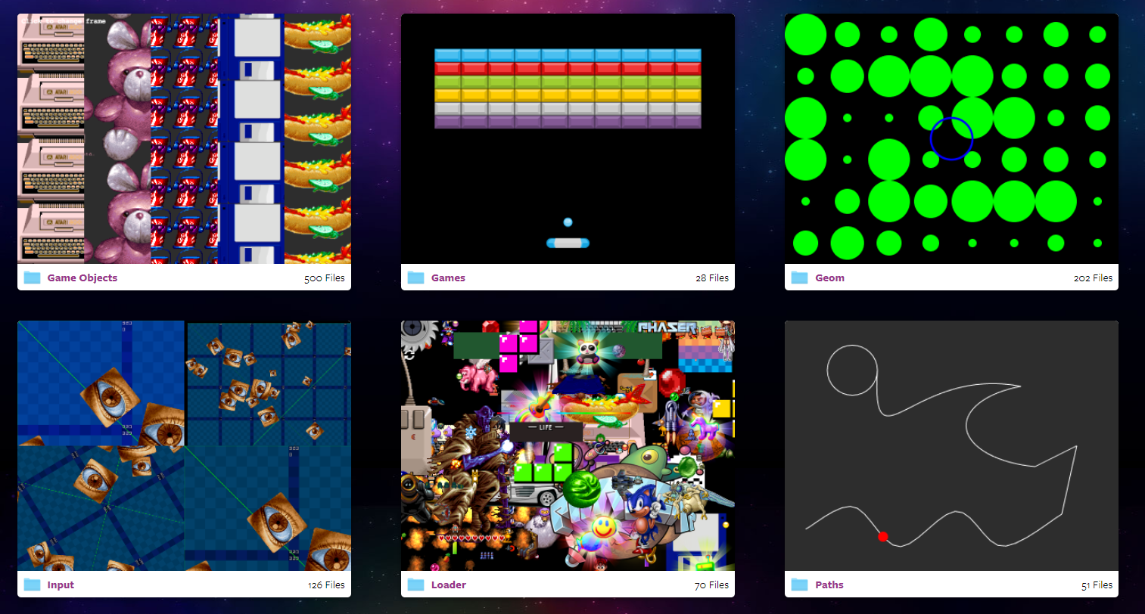
Phaser Examples
Remember that Phaser offers a lot of different support to help get more familiar in using Phaser.
The examples that are available offers a wide selection of areas ranging from audio to player movement and even examples of small games that could help improve your skills.
Phaser Examples
(https://phaser.io/examples)
Notes:
Phaser has many examples available on their website. Use them and practice each area effectively. We won't be able to cover everything to do with Phaser throughout the module but it is up to you to practice and expand your knowledge in using Phaser.

Slide 6
Environment Design
Notes:
Environment design is an important aspect when it comes to any game in the industry whether that be 2D or 3D. Your environment design may decide on the overall mood of your game.

Slide 7
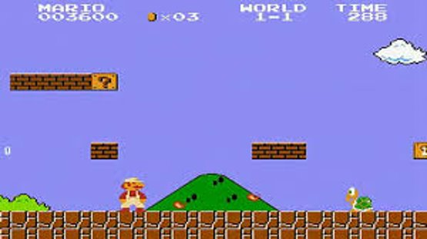
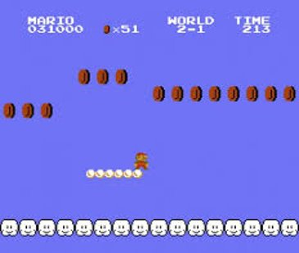
Environment Design
Use the environment to control the pace and rhythm of your game.
Do not create blank spaces!
Notes:
When designing an environment, use it to its ability to help control the overall pace and rhythm of your game. This will help have a steady flow throughout the gameplay.
Don't create a blank space just for the sake of it. Give it a use!

Slide 8
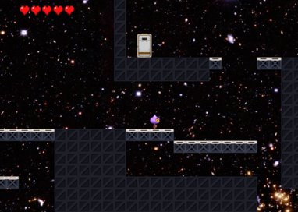
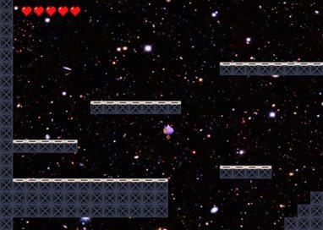
Environment Design
Study other games and their environment designs.
If a similar environment design has been applied in other games out there;
Change your design and make it unique!
While doing this, try and maintain the challenge and value to your own environment.
Notes:
When trying to think of an environment design for your own game can be difficult. Use other games to your advantage, study them and look at how unique other environment designs are from other games that are available.
If you feel like any of the environment designs are similar at all and have been applied in other games, make your design different while still trying to maintain a challenge and value to your own environment.

Slide 9
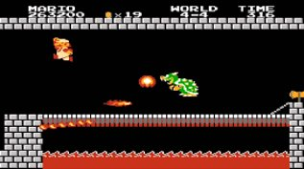
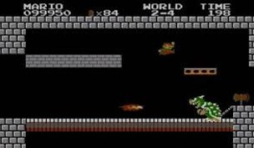
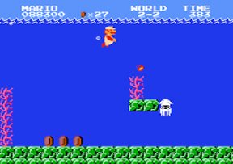
Environment Design
As the player progresses through a level/ environment, make it grow!
Quality is better than quantity!
Super Mario Bros (Nintendo)
Notes:
When thinking about your environment design, you don't want to have the same structure from beginning to end... you want to have the player progress to the point where the level feels like it's "growing" and the player feels like they are achieving something. These example images below highlight this for example with Super Mario, each level progressively got harder and harder ending with, for example, Bowser where you must dodge his fireballs and Bowser himself to get to the end game.
Think about quality more than quantity! It's better to have less of something that is greater in quality and design.
This is key when thinking about your environment design.

Slide 10
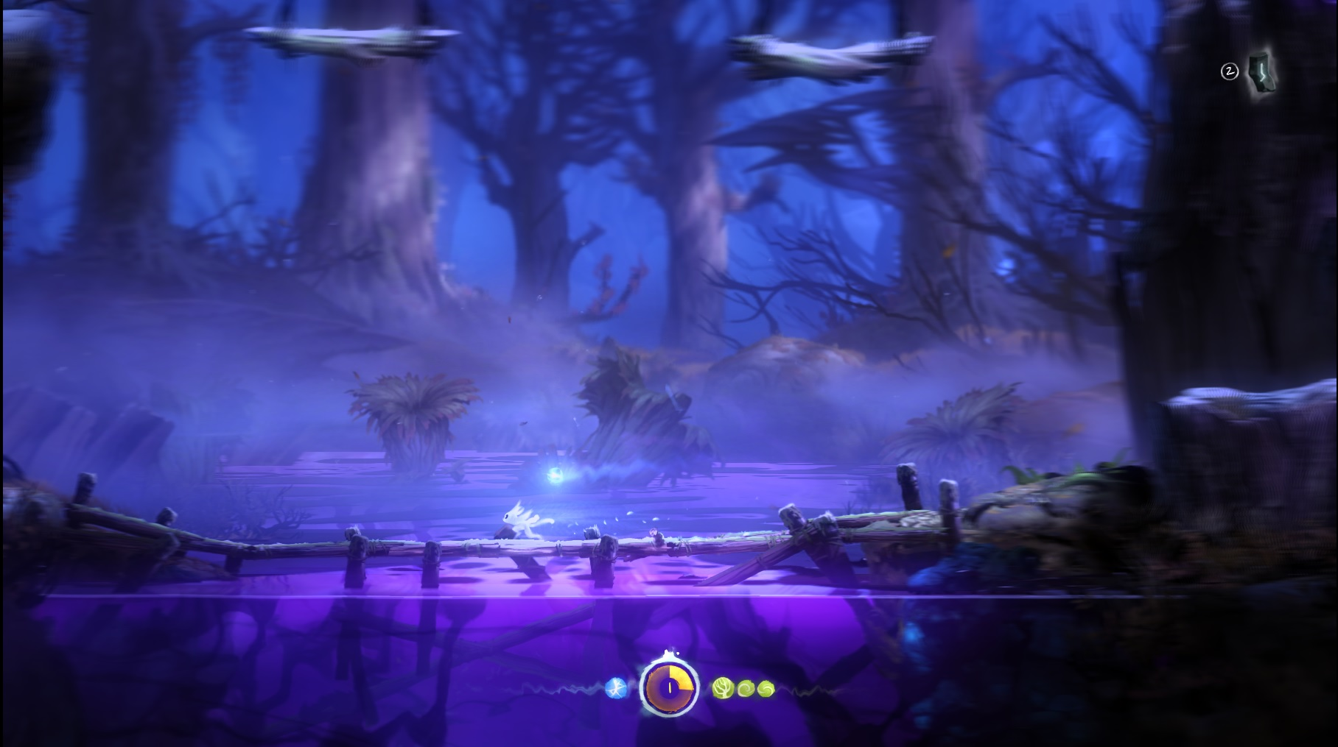
Environment Design Principles
Some of the main Environment Design principles include;
Overlap
Base-Height (Vertical perspective)
Scale
The greater the distance of an object is from where it's viewed, the smaller it will appear.
Atmosphere
It is important in creating a good atmosphere for the environment design. This will help create the overall mood for the player when playing your game.
Focus
Blur of objects in the far.
Ori and the Blind Forest
(Moon Studios)
Notes:
Some of the main principles of environment design include; overlap, base-height (vertical perspective), scale, atmosphere and focus. The Ori and the Blind Forest image on the right shows an example of focus where the environment that appears further away has more of a blur to it.

Slide 11
Phaser – Game Environment Data Format
In Phaser, the game environment is represented by tiles.
Since Phaser is a JavaScript library, there is no graphical game environment design available unless you use specific independent game environments.
Phaser uses CSV and JSON formats;
These contain a series of variables and values which determine the image and the position of the image.
The image itself is a PNG file type that contains a tilesheet of images created by tools such as Piskel.
Notes:
When working in Phaser, game environments are represented by tiles.
Phaser is a JavaScript library, therefore has no graphical game environment design available unless you use specific independent game environments; such as Tiled/ Phaser Editor 2D.
Within Phaser, they use CSV and JSON formats which you may have either previously used or are already familiar with. These formats contain a series of variables and values which help determine the image to use and the position to which that image/ tile should be placed.
The image is a PNG file type and will contain a tilesheet of images that is created in tools such as Piskel. You may also use other programs that you are experienced in to help contruct these such as; Adobe Photoshop etc.

Slide 12
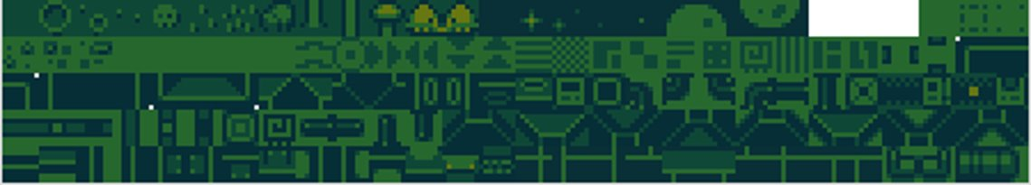

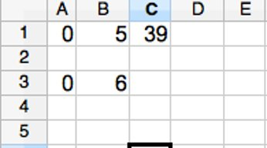
Comma-Separated values (CSV)
Determine the size of the tiles in correspondence to the image.
You want to create a sequence of numbers that help determine the image to be displayed on the tiles.
The first number will show the first tile at the top left of the game window.
A new row within the CSV file means;
Create a new row of tiles in the game environment.
The game environment within Phaser is represented as tiles.
Notes:
When working with CSV (Comma-Separated Values), you have to determine the size of the tiles in correspondence to the image/ tileset.
First of all, you want to create a sequence of numbers that will help determine the image that will be placed in that tile. The first number below will show the first tile at the top left of the game window (see images).

Slide 13
JavaScript Object Notation (JSON)
JSON (JavaScript Object Notation) is a lightweight data-interchange format which is easy for humans to read and write and especially for machines to parse and generate (http://json.org/).
JSON is ideal for data interchange between languages.
JSON consists of two elements;
A collection of name/ value pairs.
{ string1 : value1, string2 : value2, … }
An ordered list of values.
[ value1, value2, …]
Therefore, one name can have multiple values;
{ string1 : [value1, value2, …], string2 : [value11, value12, …], …}

Slide 14
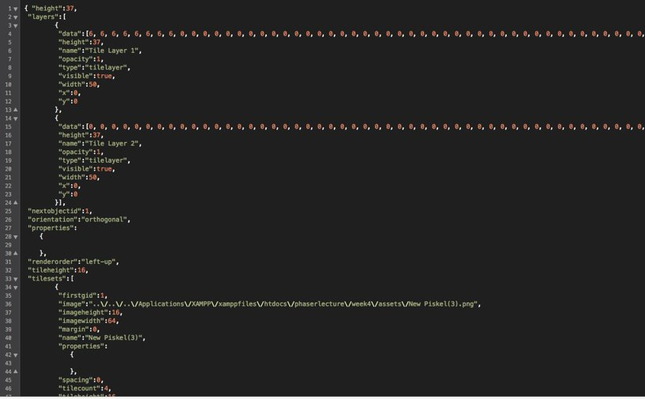
JSON in Phaser
Notes:
Layers:
Data
Height
Name
Type
Visible
Width
X
Y
Orientation: Orthogonal
Tileheight:
Tilewidth:
Tilesets:
Firstgid
Image
Imageweight
Imageheight
Spacing
Tilecount
Tileheight
tilewidth

Slide 15
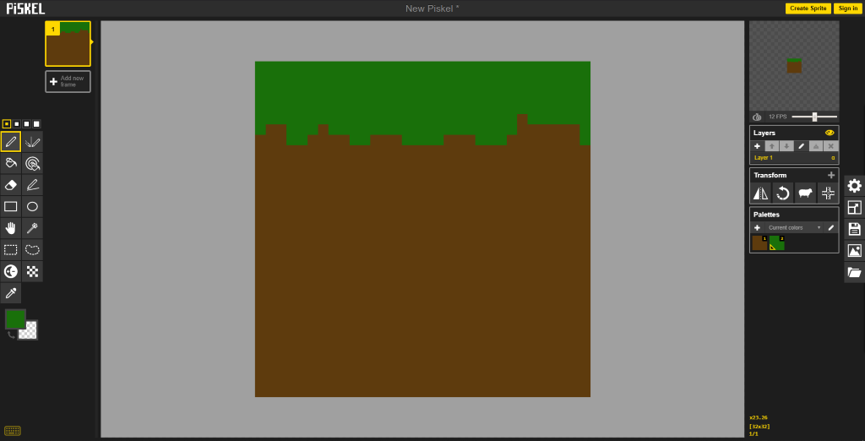
Resources for Game Environment
Piskel can be used to help create assets and spritesheets.
Notes:
In the lab, we will be looking at using Piskel as a design task for this week. You will look at starting to create you own assets/ spritesheets within this and continuing this into another program called Tile to help generate a tilemap in the appropriate format.

Slide 16
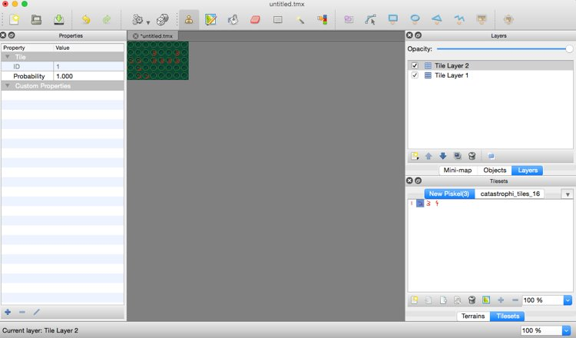
Resources for Game Environment
Tiled can be used to help design and generate a tilemap, exporting it to the appropriate format of CSV or JSON.
Notes:
Using what we create in Piskel, we will look into Tiled and how you can use these spritesheet/ tilesets to help further design and develop a game environment and generating it effectively.

Slide 17
Resources for Game Environment
Tiled
Tilesets Window; allows you to add and remove tilesets resources effectively.
Layer Window; allows you to effectively add and remove layers.
Tilemap Window; allows the player to design their game environment.
Step to follow;
Add in the tilesets.
Drag and drop particular tiles from the tilesets window to the tilemap window.
If multiple layers are intended, create layer(s) as required in the layer window before adding tiles to the intended layer.
Notes:
Points for working within Tiled.

Slide 18
Loading a Game Environment Within Phaser
When loading a tilemap in Phaser, you normally would do so in the Preload state.
load.tilemap('tilemapVarNameJSON', 'tilemapJSON.json', null, Phaser.Tilemap.TILED_JSON);
Load.tilemap('tilemapVarNameCSV', 'tilemapCSV.csv', null, Phaser.Tilemap.CSV);
Load the spritesheet, which is also normally in the Preload state.
load.image('tilesetVarName', 'tileImage.png');
Notes:
This gives an example of how you would effectively implement a game environment into Phaser.

Slide 19
Game Environment – Display CSV Resources
To display the CSV resources, you would normally do this within the Create state.
add.tilemap(variablename, width, height);
add.tilemap('tilemapVarNameCSV', 16, 16);
Then to add the tileset.
addTilesetImage('tilesetVarName');

Slide 20
Game Environment – Display JSON Resources
To display the JSON resources, you would normally do this within the Create state also.
add.tilemap(variablename, width, height);
add.tilemap('tilemapVarNameJSON');
Then to add the tileset.
addTilesetImage('Name of the image specified in JSON generated by Tiled', 'variable name when loading the spritesheet');
addTilesetImage('New Piskel(3)', 'tiles');

Slide 21
Game Environment – Multiplayer
To create a multiplayer game environment you would want to;
Load the tilemaps and tilesets in the Preload state.
Create a layer array variable such as;
var layer = {};
You then, add tilemap and tilesets.
Finally adding the layers specified in JSON to the array.
layer[0] = map.createLayer('Tile Layer 1');
layer[0].resizeWorld();
layer[1] = map.createLayer('Tile Layer 2');
layer[1].resizeWorld();
Notes:
Throughout the labs we will have the ability to experience using both Piskel and Tiled to get familiar in using these programs.

Slide 22
Phaser 3 API Documentation
The Phaser 3 API Documentation offers all the information needed when working with Phaser 3.
If you have previously worked with Phaser 2 in the past, you may notice that Phaser 3 is significantly different in places.
Phaser 3 was re-built in areas to give it a more Object-Oriented approach.
https://photonstorm.github.io/phaser3-docs/index.html
Keep this link handy as it is always good to refer to if you are having any problems!

Slide 23
References
Oxland, K. Gameplay and Design. Addison-Wesley
www.piskelapp.com/
http://www.mapeditor.org/

